Slide 1
My Culinary Internship at Sodexo in Chicago Botanic Gardens
Grace Cucco

Slide 2
What I Did
This summer I worked for Sodexo at CBG.
I worked in all the food service locations around the park
I worked different shifts in different locations
I learned about the different jobs people have and how Sodexo operates

Slide 3

About Sodexo
French food services and facilities management company
CBG is a part of the smallest section: Sports and Leisure
Sodexo serves many sections such as hospitals, universities, and big corporations
18th largest employer in the world

Slide 4
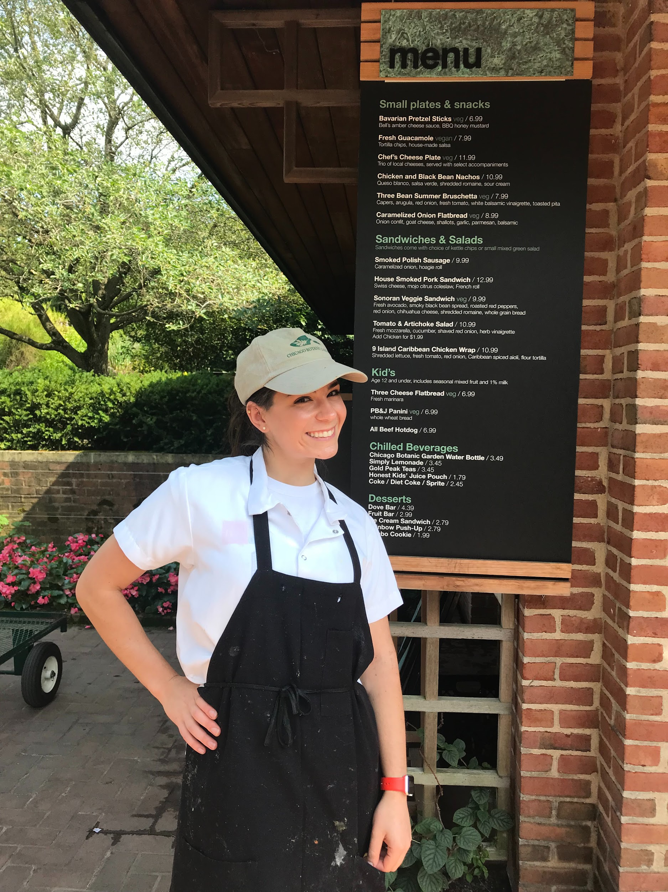
Beer Garden
Learned how to open
Learn how to close
Prepare all menu items
Learn how inventory works
Learn how the Beer Garden connects to other CBG Sodexo locations

Slide 5
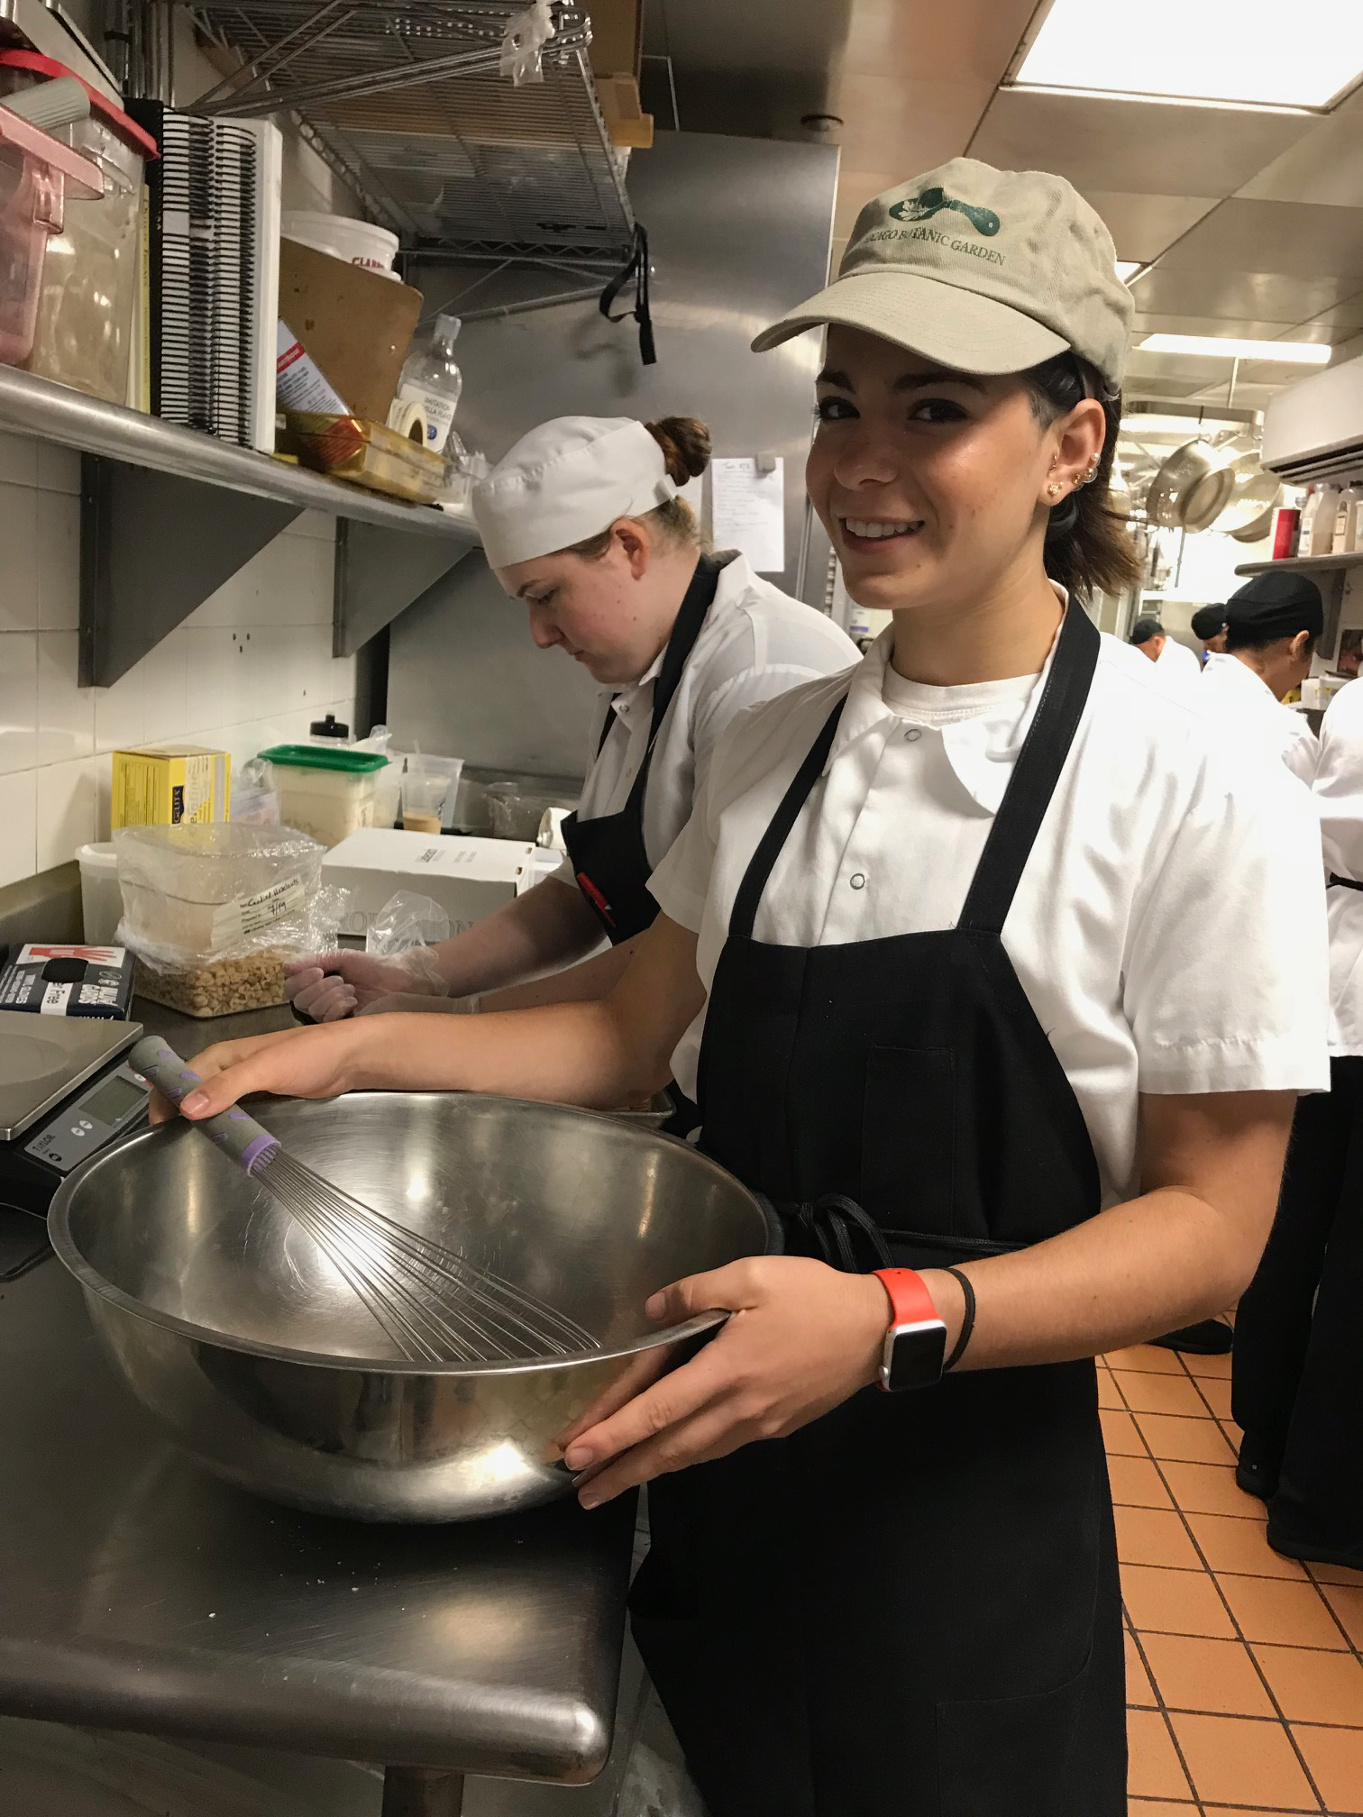
Pastry
Look at recipes
Learn how to make pastry items
Learn where recipes are from and how new ones are
found
Stock pastry for the cafe
Make dessert items for catered events

Slide 6
Expediting
Learn how to read a ticket
Learn what each menu item looks like
Learn what sides go with what food
Learn how the tracker system works and how to use the computer
Learn how to direct runners
Learn attention to detail

Slide 7
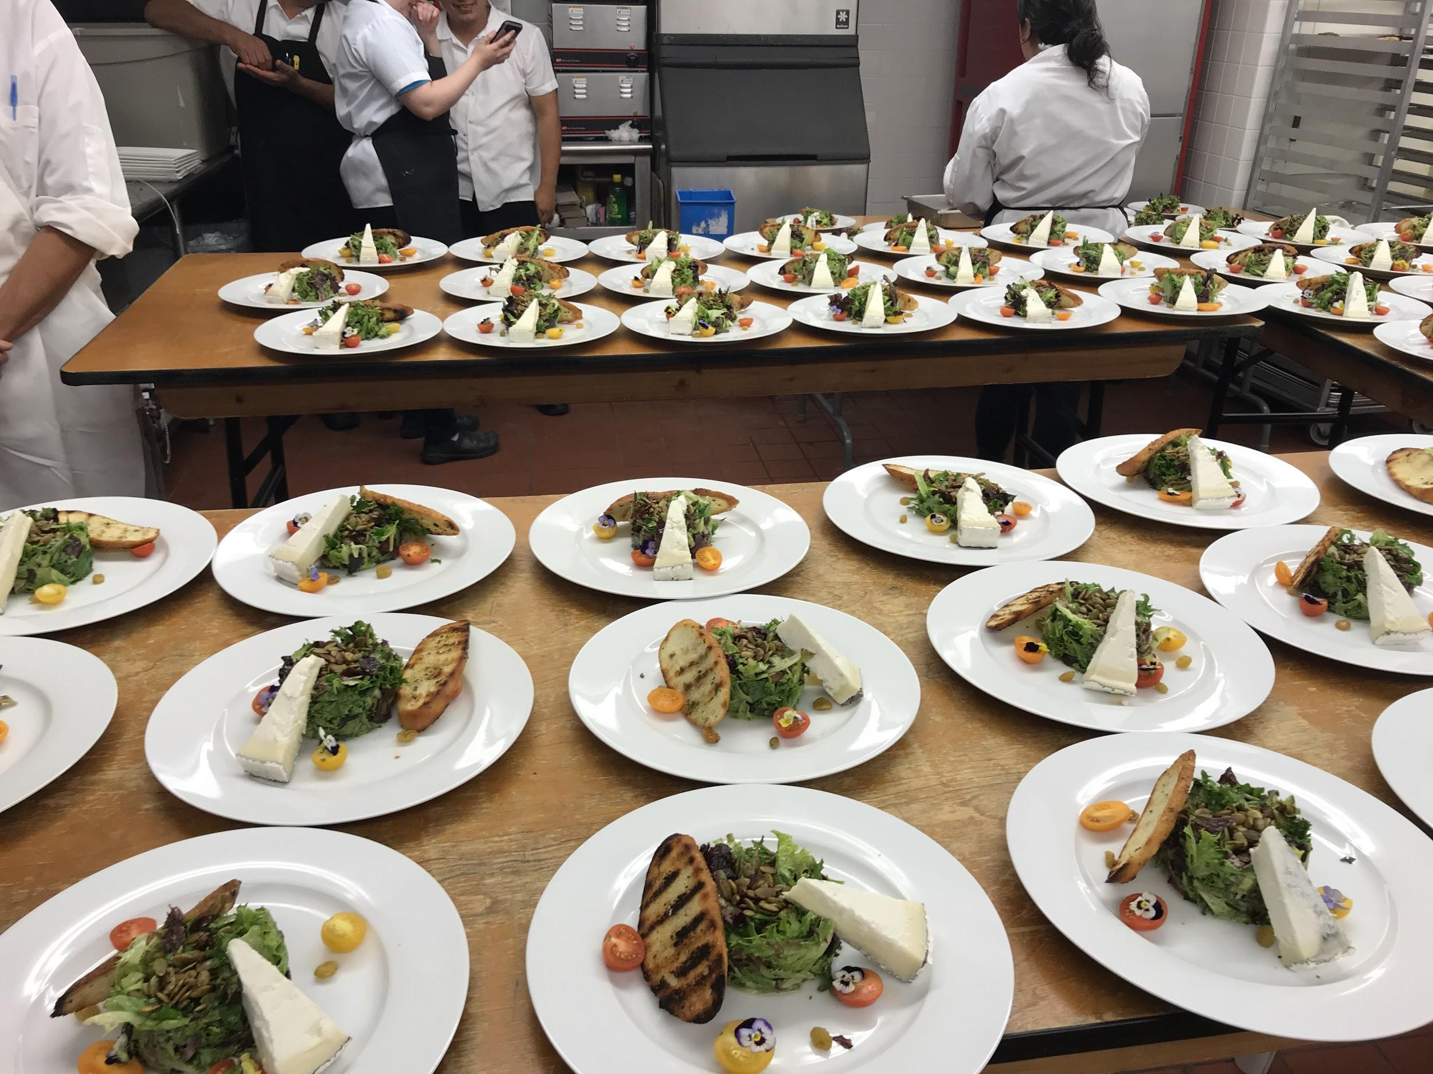
Catered Events
Work late at night
Be quick, precise, and patient
Be able to work under pressure
Look at BEO’s
Take directions and work under pressure

Slide 8
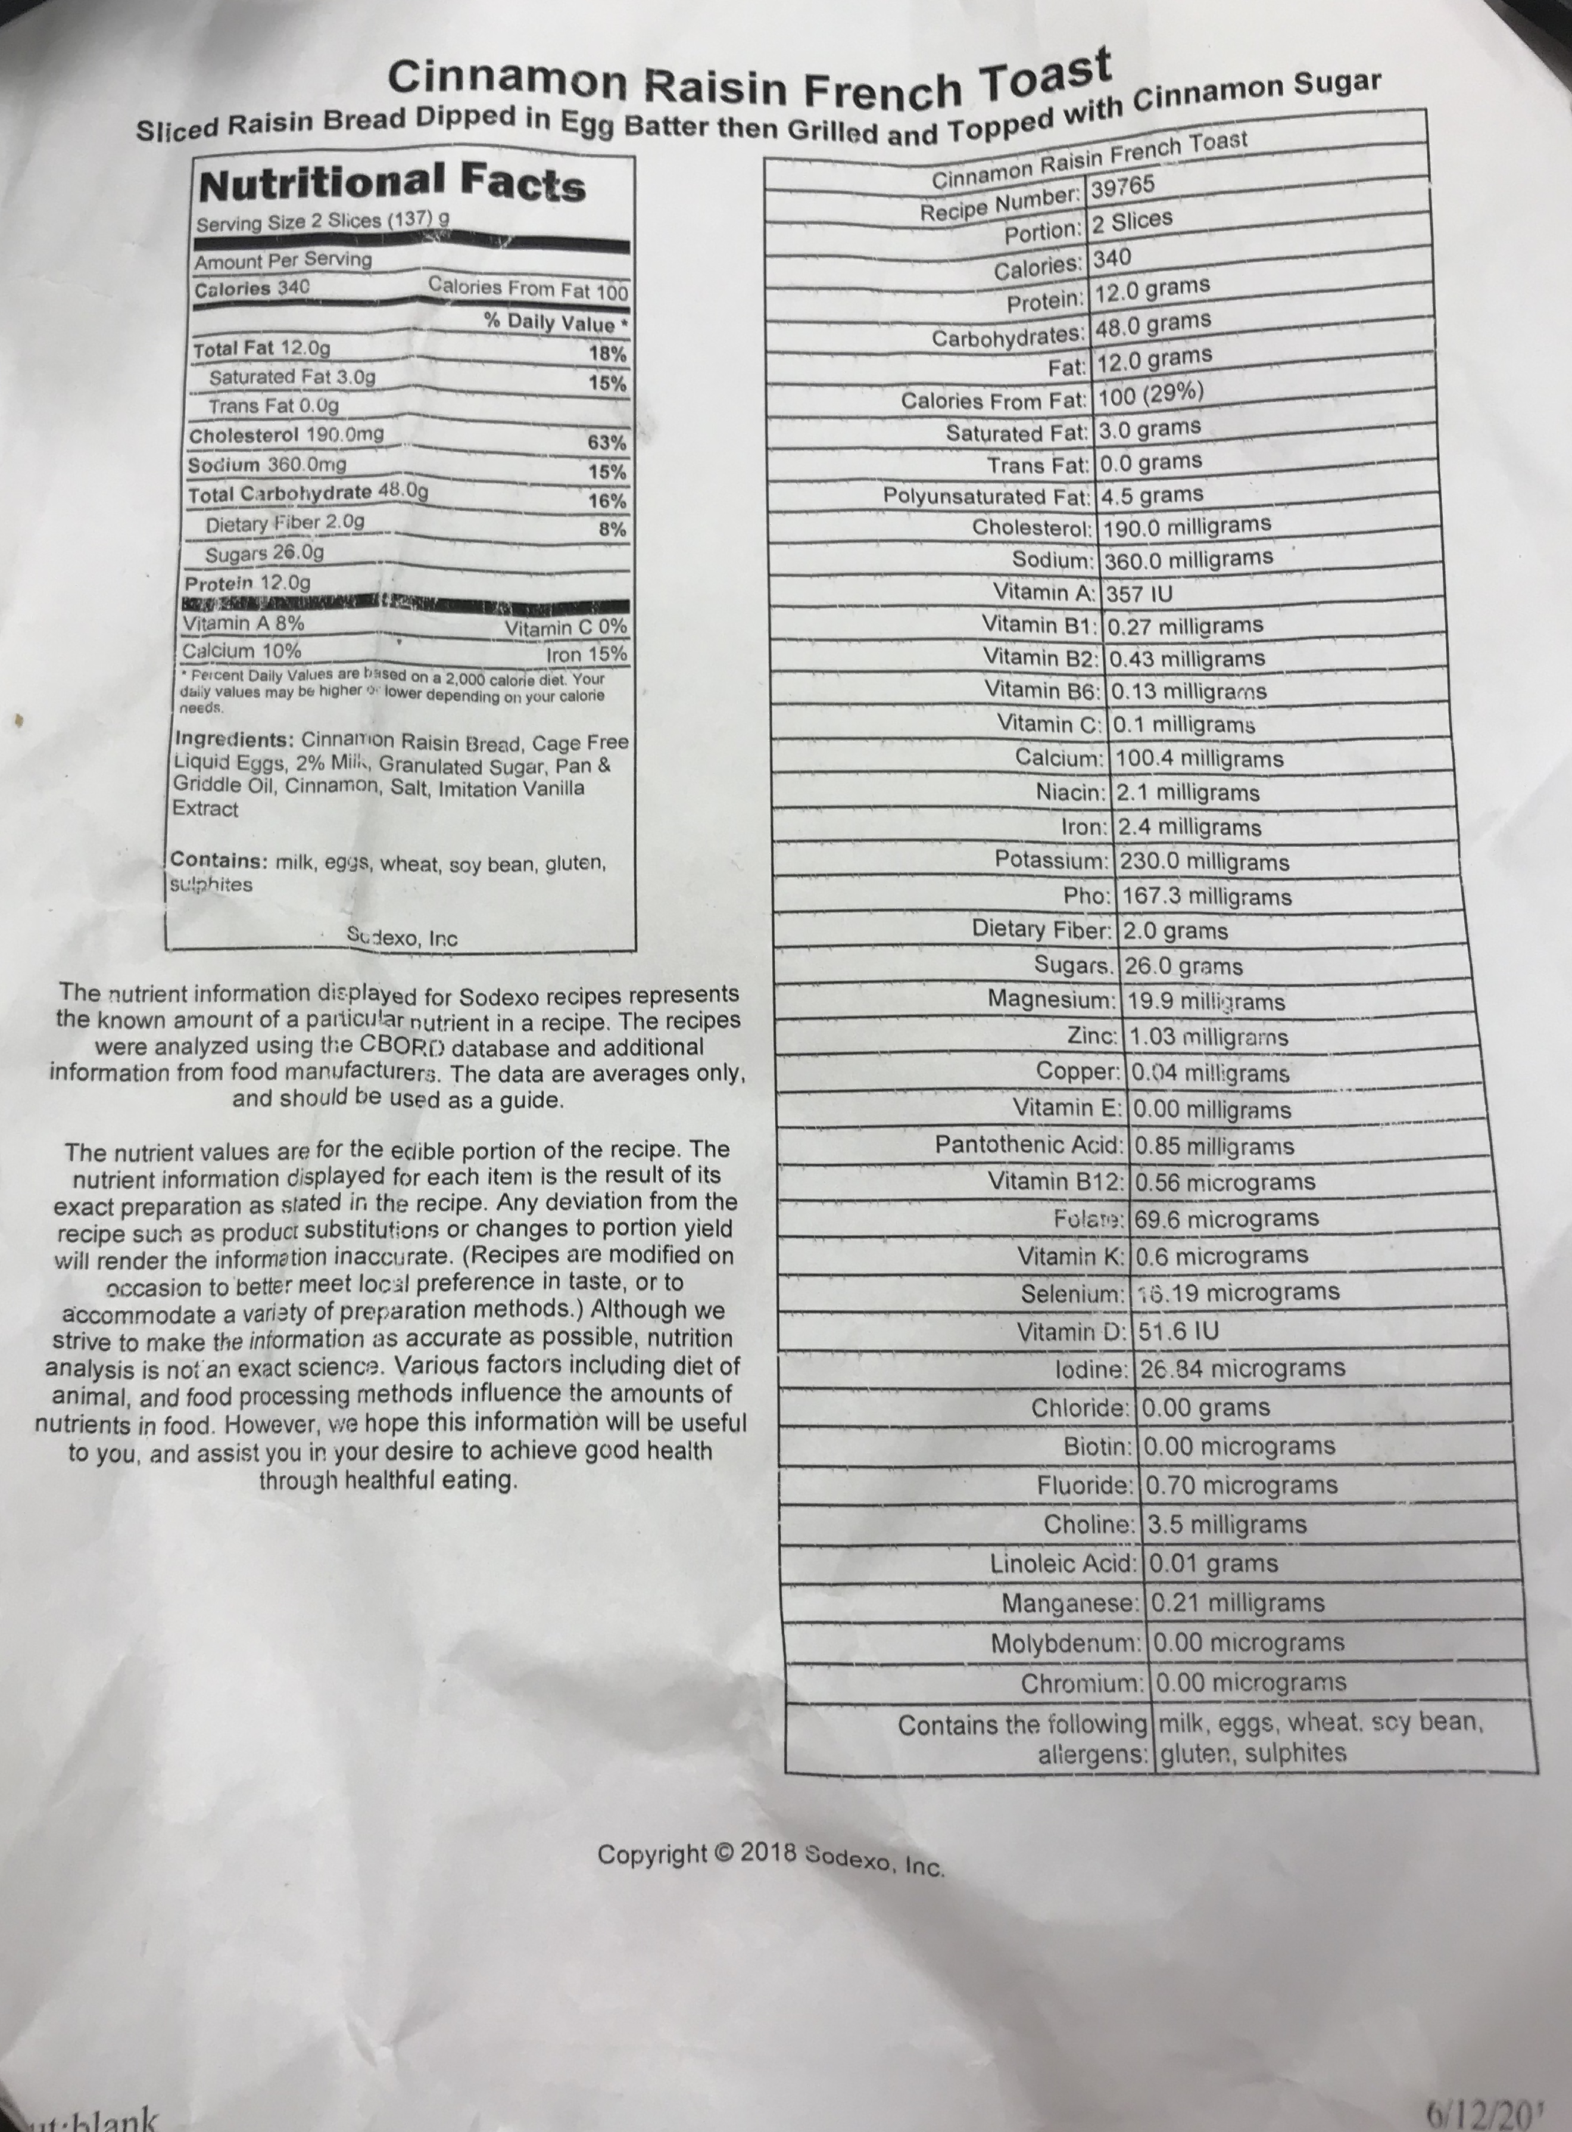
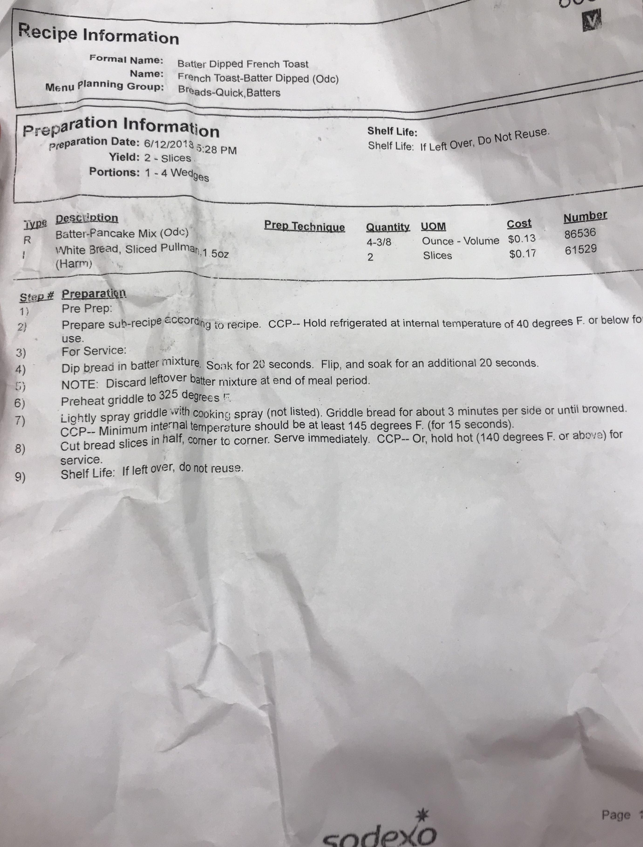
Working with the Chefs
See the inventory system
See how to order food
Reformulate labels for allergens
Ask chefs how I can help and be ready to work anywhere

Slide 9
What I learned
All the components of a kitchen and how it operates
How management of a kitchen is handled
How big companies like Sodexo

Slide 10
How it’s Applicable
Food systems management
How restaurants and leading companies in the food industry are dealing with obesity issues and serving healthy food
How a kitchen operates
How to prepare food
Health and safety risks and training

