Slide 1
Free & Smooth smoothie truck
Jessica Brown & Grace Cucco

Slide 2

Who we are
We noticed a need for restaurants and/or food trucks that have a limited options for customers with food allergies
Goal: Desire to provide healthy smoothies for those with food allergies

Slide 3
Market Research
Many directions to go with your idea that allows freedom of use
Many quit their 9-5 jobs to follow their dream
LEED qualities
Charity work
Crazy truck design
Use of Farmers market
Use of social media
Notes:
Through the market research, we learned how many directions food truck vendors go with their company. Many go out on their own to start their project with very little funding, taking a great deal of time out of their schedules. Most have quit their 9-5 jobs to begin their entrepreneur lifestyle. Once they have a plan in action they really do run with what they have, being that they try their best to get their idea out into the world as fast as they can while still sticking to government and state regulations and satisfying their customers.
Almost all had some sort of LEED in their truck’s design. This was typically done by using biodiesel fuel which we planned to use in the truck that pulls the trailer. Also, we will be using biodegradable utensils and cups or bowls like many of the trucks used. Once our business grows, we hope to take part in charity work such as putting on fundraisers for schools across LA or participating in food truck fairs at a charity walk.
As we were looking at all the food trucks, we noticed how intricate all the designs were. This was to catch the eye of potential customers and to make them have interest in what we are all about. This will help grow our clientele in addition to the advertisements we plan on doing. A good portion of the trucks stressed how important advertising in the form of social media is due to the variable locations they will be in. While we plan on initially staying stationary at The Original Farmers Market in LA, we will still being using social media to gain a following of the truck to help our future loyal customers learn about where we will be next, what events we are doing, and about our new menu items.

Slide 4
HACCP Procedures
Describe the food and its distribution
  The food has will be served cold and stored at the appropriate temperature. There will be a thermometer that is checked each shift to ensure the refrigerator is at the proper temperature. The food will be distributed through the trucks service window. Customers can line up, order their food, pay and receive their order from the window of the truck. Any necessary utensils will be given to the customer from the service worker when they are given their order.
Intended use and customers of the food
  The food will be served to customers passing by the farmers market or whatever location we are stopped. It will be portable so they are free to eat it wherever they wish.
Notes:
Procedures
Describe the food and its distribution
The food has will be served cold and stored at the appropriate temperature. There will be a thermometer that is checked each shift to ensure the refrigerator is at the proper temperature. The food will be distributed through the trucks service window. Customers can line up, order their food, pay and receive their order from the window of the truck. Any necessary utensils will be given to the customer from the service worker when they are given their order.
Intended use and customers of the food
The food will be served to customers passing by the farmers market or whatever location we are stopped. It will be portable so they are free to eat it wherever they wish.
Flow Diagram of the Process
Principles
1. Conduct hazard analysis
a. Does the food have any ingredients with microbiological hazards?
b. Are there any chemical or physical hazards such as mislocation of cleaning equipment?
c. Does potable water need to be used and where will the water come from?
d. What hazards may arise if there is any cross-contamination?
e. Does the food allow for the survival or multiplication of pathogens in storage?
f. Are thermometers being used to ensure consumer safety?
g. Will there be any misconduct in how the food is obtained?
2. Determine Critical Control Points
To prevent bacterial growth the fruit and milk, they will be stored at 32 degrees fahrenheit using a calibrated thermometer in the freezer and refrigerator.
3. Establish Critical Limits
The fruit will be stored at a low humidity and will not be served past its expiration date
4. Establish monitoring procedures
Every type of fruit will be tested at the beginning of each shift by the employees to make sure it is being stored at the proper temperature. It will then be recorded on the food temperature chart.
5. Establish Corrective Actions
If the refrigerator temperature is not at the ideal level, then the temperature will be adjusted. If it has been an extended period of time since the temperature was last checked, then the fruit will be discarded. Every time the temperature is taken, it will be recorded on the food temperature chart until the safe temperature is met.
6. Establish verification procedures
At the beginning of each season, the managers and employees will be taught the procedure as part of training. The manager will will review the HACCP and verify that it is functioning properly. At the end of every week, they will check the food temperature sheets to make sure that all food is being served at the proper temperature.
7. Establish record-keeping and documentation procedures
The HACCP plan will be posted on the wall of the van so that any employee can review it if needed. It will say what temperature the refrigerator should be as well as how to calibrate and use a thermometer. In the truck we will keep a binder of the food temperature sheet for the week to be stored. At the end of the month, the owners will review each weeks temperature sheet and place the papers in a yearly binder, separated by months.

Slide 5
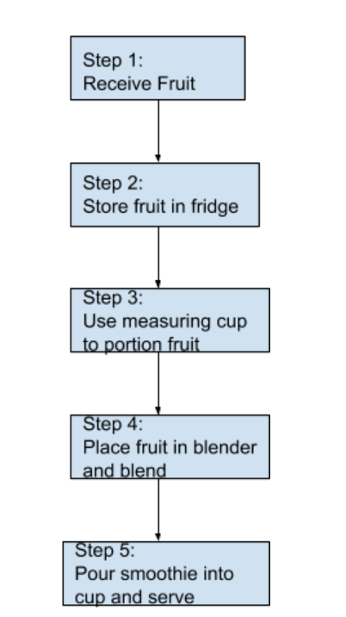
HACCP Flow Chart

Slide 6
Principles
1. Conduct hazard analysis
a. Does the food have any ingredients with microbiological hazards?
b. Are there any chemical or physical hazards such as mislocation of cleaning equipment?
c. Does potable water need to be used and where will the water come from?
d. What hazards may arise if there is any cross-contamination?
e. Does the food allow for the survival or multiplication of pathogens in storage?
f. Are thermometers being used to ensure consumer safety?
g. Will there be any misconduct in how the food is obtained?

Slide 7
Principles
2. Determine Critical Control Points
To prevent bacterial growth the fruit and milk, they will be stored at 32 degrees fahrenheit using a calibrated thermometer in the freezer and refrigerator.
3. Establish Critical Limits
The fruit will be stored at a low humidity and will not be served past its expiration date
4. Establish monitoring procedures
Every type of fruit will be tested at the beginning of each shift by the employees to make sure it is being stored at the proper temperature. It will then be recorded on the food temperature chart.

Slide 8
Principles
5. Establish Corrective Actions
If the refrigerator temperature is not at the ideal level, then the temperature will be adjusted. If it has been an extended period of time since the temperature was last checked, then the fruit will be discarded. Every time the temperature is taken, it will be recorded on the food temperature chart until the safe temperature is met.
6. Establish verification procedures
At the beginning of each season, the managers and employees will be taught the procedure as part of training. The manager will will review the HACCP and verify that it is functioning properly. At the end of every week, they will check the food temperature sheets to make sure that all food is being served at the proper temperature.
7. Establish record-keeping and documentation procedures
The HACCP plan will be posted on the wall of the van so that any employee can review it if needed. It will say what temperature the refrigerator should be as well as how to calibrate and use a thermometer. In the truck we will keep a binder of the food temperature sheet for the week to be stored. At the end of the month, the owners will review each weeks temperature sheet and place the papers in a yearly binder, separated by months.

Slide 9
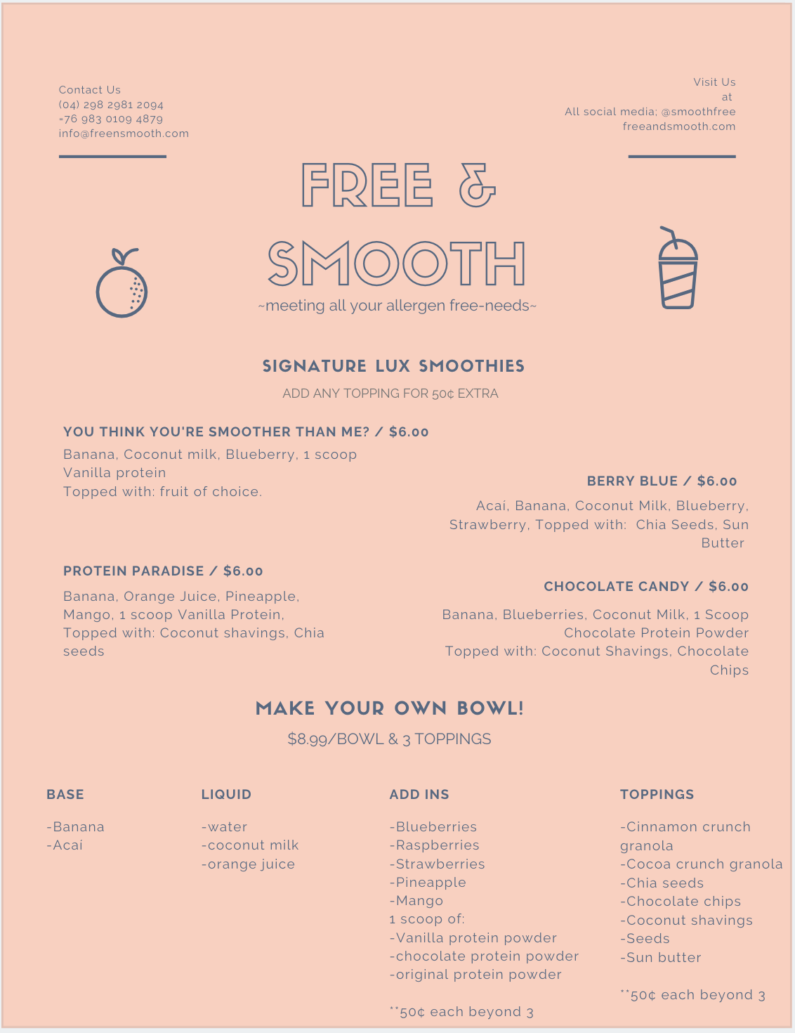
Menu
Option to make your own bowl or a a signature smoothie
All ingredients will be allergen free and organically sourced inside california
  peanuts, dairy, soybean, and eggs
$6.00 for signature smoothie + 50¢ for each add-in or topping
$8.99 for make your own bowl
  Choose as much as you would like for add-ins, each topping is 50¢ extra

Slide 10
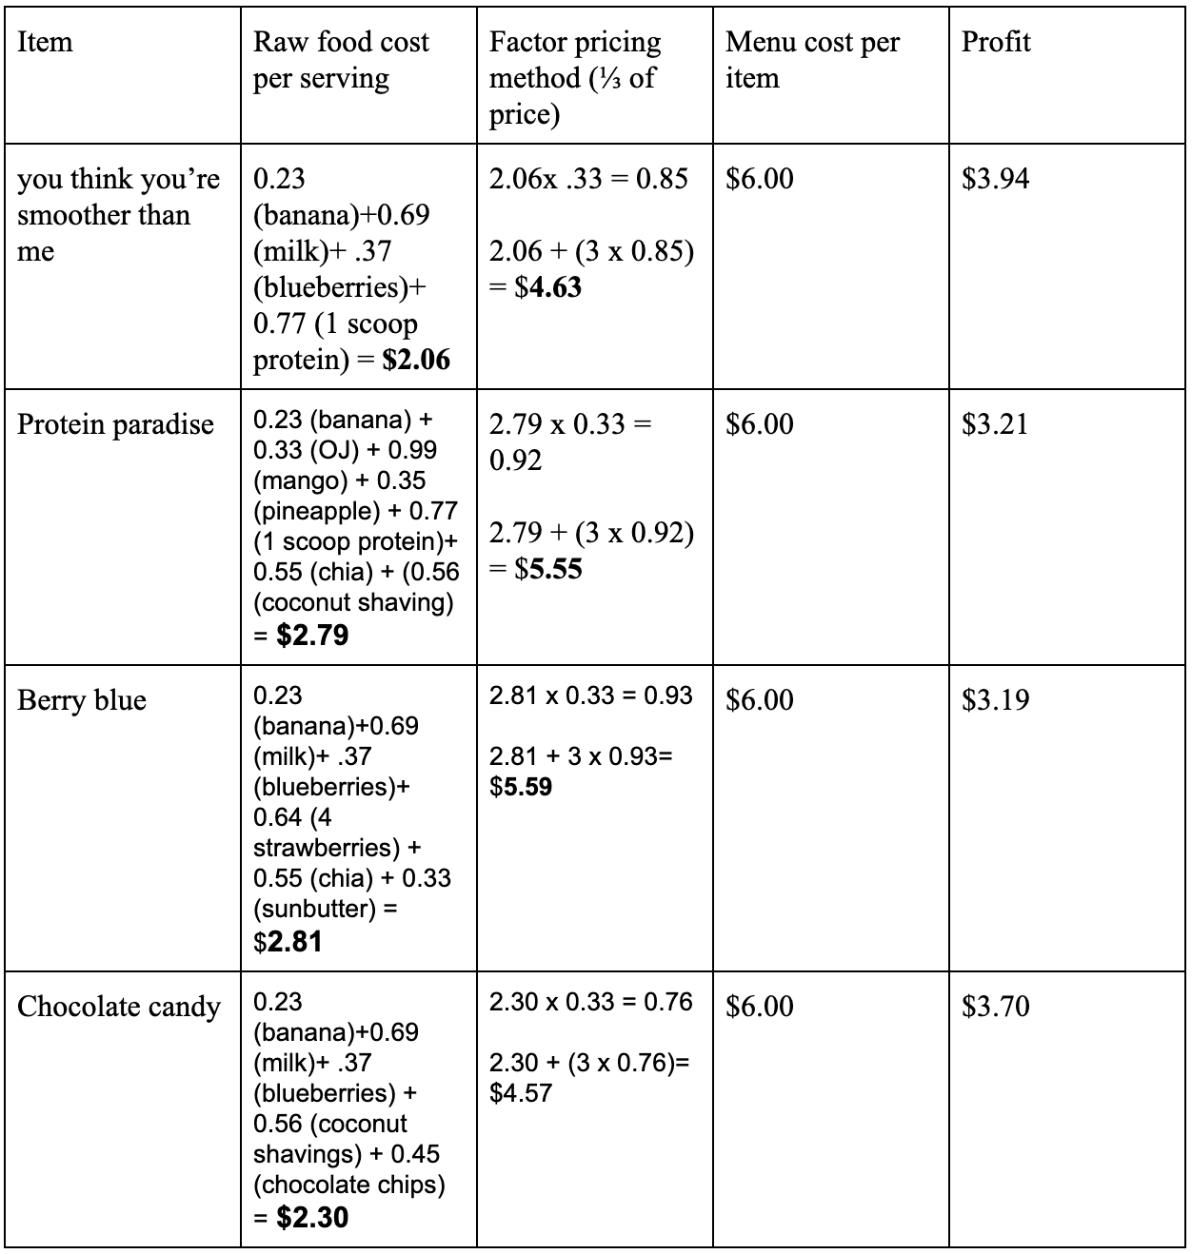
Factor pricing method
Used ⅓ of the raw food cost to cover labor, ⅓ for materials, and ⅓ + remainder for profit

Slide 11
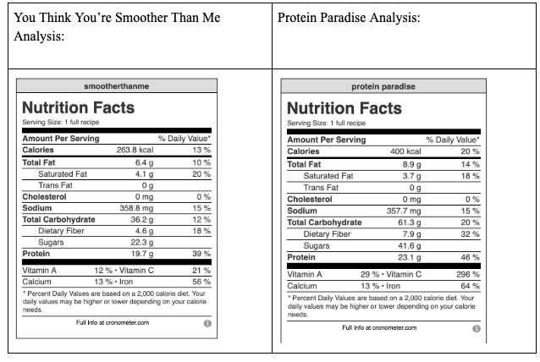
Nutritional analysis of items pt. 1

Slide 12
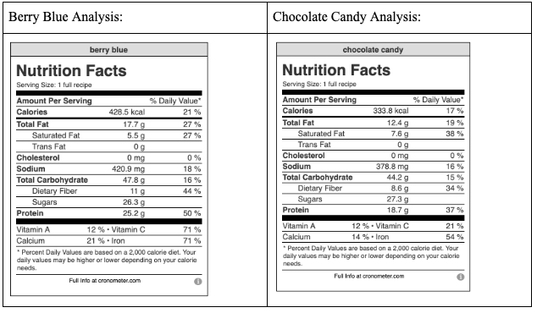
Nutritional analysis of items pt. 2
Notes:
We cannot provide a nutrition analysis report because our menu does not have the variety needed to provide 3 meals a day nor are we open for this amount of time. We assume that our customers will be drinking our smoothies as a post-breakfast or post-lunch snack, and not as a meal. Our menu items are a good addition to an already balanced diet containing plenty of healthy fat and protein sources.
Our smoothies have no added sugar, but are high in carbohydrates by nature, making them a great pre or post workout snack rather than a whole meal. Overall, each of the smoothie’s calories range between 300-500 kcals per serving.
They all contain high values of fruit which bring in healthy amounts of antioxidants to the diet and at least 1 serving of fruit per smoothie. The protein in each smoothie is no more than 25 grams, which is the recommended amount of protein a person should have per sitting.

Slide 13
Quantified recipe
Quantified:
150 bananas
18.75 gallons orange juice
75 cups mango
75 cups pineapple
300 scoops protein powder
600 tablespoons chia seed
600 tablespoons coconut shavings
Instructions
Place all ingredients in blender
Blend ingredients
Pour portions into serving cups
Original Recipe: Protein Paradise
½ banana
1 cup orange juice
¼ cup mango
¼ cup pineapple
1 scoop protein powder
2 tablespoons chia seeds
2 tablespoons coconut shavings
Notes:
For use when we become more acclimated to the business and start doing charity work

Slide 14
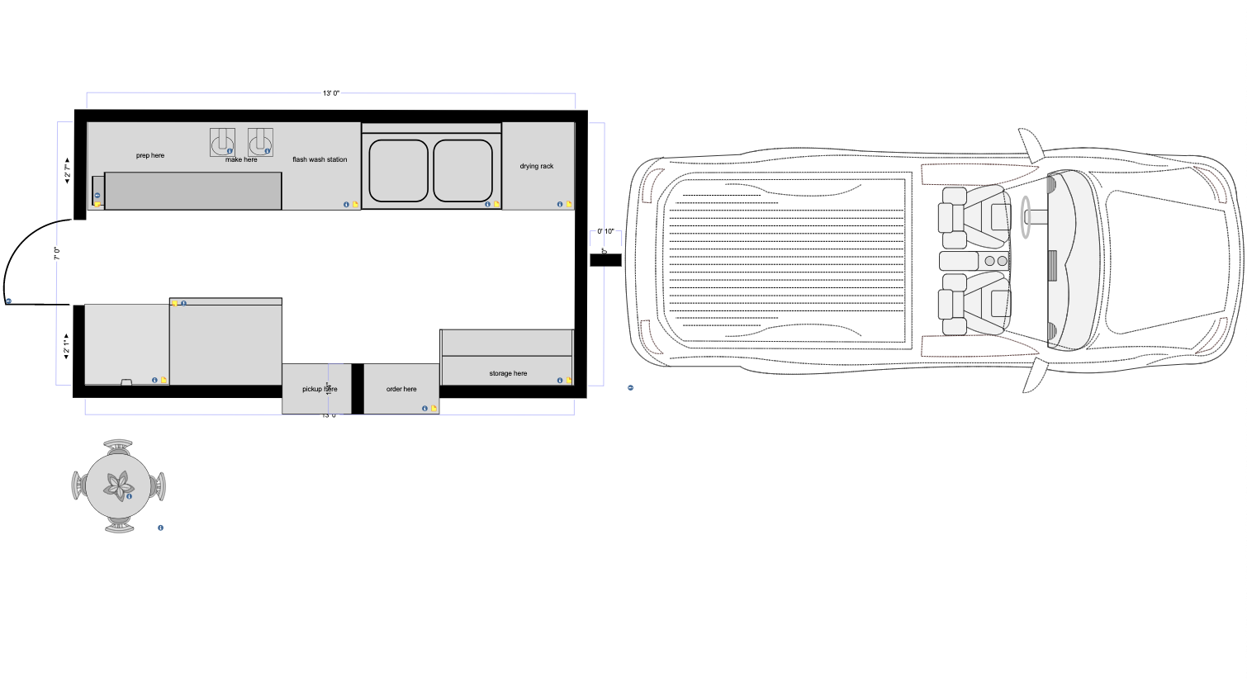
Truck description
13ftx7ftx7ft
Pulled by truck we already own
Main door in the back
Working station
Two compartment sink
Pantry
Order/pickup window
Freezer and refrigerator
Notes:
The food truck will be 13 ft L x 7 ft W x 7 ft H and will be pulled by the already owned truck that will hold excess equipment such as chairs, tables, and overflow ingredients. This will allow full mobility of the truck such as where we park the truck for the day.
the truck a pale pink with our logo covering the entire front of the truck. This will be in magenta, cursive font. On the right side of the window, the menu and pricing will be placed listing options of smoothies and potential ingredients for their custom smoothie. We will also have a menu taped to the shelf that reaches out of the unit.
Inside the truck, there will be a work counter used for cutting and preparing the ingredients. Below the workstation will be shelves holding cups, straws, and utensils. On the station, there will be two industrial Blendtec blenders with 20 inches of space per unit then one blendtec JRE-612 rapid rinse cleaning system next to them, again having 20 inches of space per unit. Along that same wall, there will be a large, two compartment sink including two 18 inch drain boards on both sides and two 8’’ faucets.
Above the sink will be soap and sanitation fluid dispensers along with wet wipes to wipe surfaces down throughout the operation day.
a storage unit holding excess non-perishable ingredients that need not to be refrigerated, utensils, cups, straws, napkins, and cleaning materials including extra sanitation soap, mopping fluid, counter cleaner, sponges, mops, reusable towels, etcetera.
The service station where orders will be taken is to the left of to the storage unit and customers will receive their order in the window directly next to that. In addition to this window, there will be a door on the left 7ft wall, which will remain unlocked at all times with the option to stay open to prevent overheating of the truck.
the far left of the truck will have an industrial refrigerator and chest freezer holding all of the ingredients that must be held in cold temperatures such as frozen or fresh fruit.
Outside of the truck on the side of the right 7ft door will be the 30-gallon, plastic potable water system. which will be filled via hose from a nearby water source and cleaned with a water filter. Being at a farmers market, this will be provided by the location and city. There will be a water pump and water heater directly below the sink. The wastewater/grey water system will be 45 gallons (50% more of the potable water volume required in grey water tanks per California code) which will be emptied into a sewer drain found near our location and has been verified for use. This will be checked at noon and empties at the end of the day.
Our design will be set up this way to allow full mobility for our workers, as the prep crew can have their own location on the back side of the truck and servers on the front; they will have everything they need in their area to do their job in an effective and efficient manner to give our customers a speedy yet pleasant experience.
There will be just about 30 inches of aisle space in between the workspaces and about 53 inches in between the workspace and the window. to help prevent workers from bumping into each other and increasing space. It is also important to note that all the work stations, shelves, and appliances will be made of stainless steel to allow ease of cleaning and durability.

Slide 15
Operation hours and location
10:00 A.M. to 2:00 P.M.
The Original Farmers Market of Los Angeles
Will start out being permanently parked at this location then venture out in the future

Slide 16
Regulations
Vehicle inspection by Public Health department of LA county
Zoning department
Public health permits by Public Health department of LA county
California State Health Department
LA County Health Department
California state business license
California House and Community Development
EPA
FALCPA
ServSafe and food handlers permit
California meal break law
Notes:
The truck itself will be certified and inspected by the department of housing and community development as well to allow use in the city of Los Angeles
We will be located within 200 feet of an approved available toilet and handwashing facility that has been approved by the enforcement agency for the use of our customers and workers.
EPA: We will be using all organic and trusted brands for our ingredients to ensure no cross contamination of potential allergens and harmful pesticides. We desire the best for our customers and will always do our research and ask questions about where the product was sourced plus how it was made
FALCPA: Food Allergen Labeling and Consumer Protection Act:
cross contact can and should not occur through all hours of operation. Our equipment, and ingredients, have been inspected thoroughly to be sure that there has been zero contact with allergens through production and development of such. To clean our blenders, we will acquire the Blendtec JRE-612, a rapid-clean cleaning system that deep cleans the Blendtec blender thoroughly after use, especially when coconut milk was used as an ingredient. This will be used to ensure that no trace contents of coconut residue will be passed over to the next customer.
Servsafe: each employee will be certified within 30 days of hire
Meal break: every employee will receive a 30 minute break around lunch time provided by that on-duty manager

Slide 17
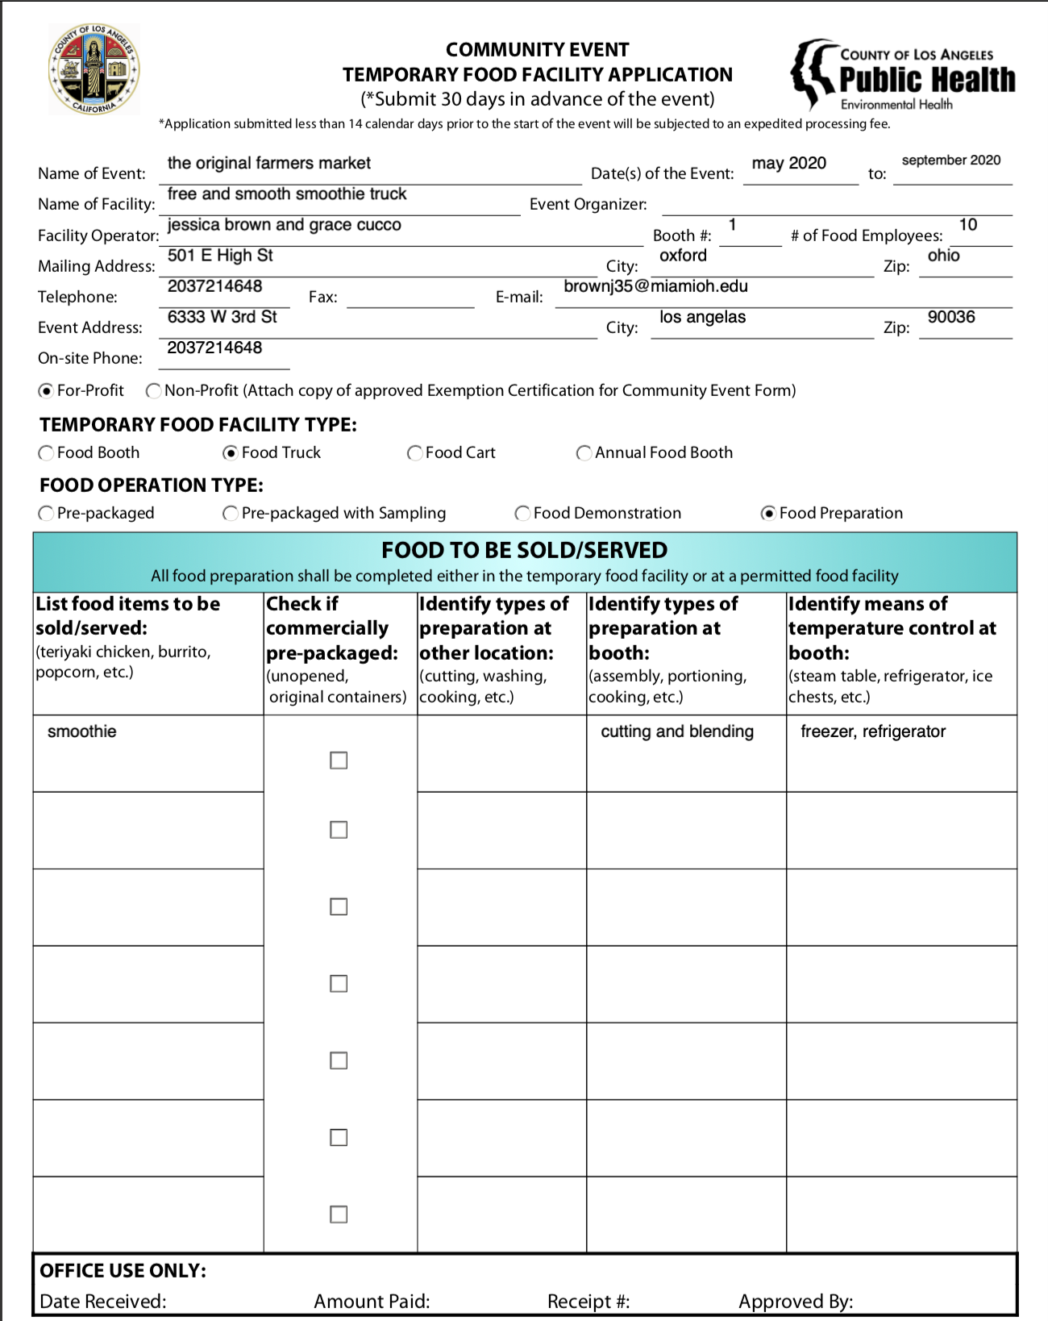
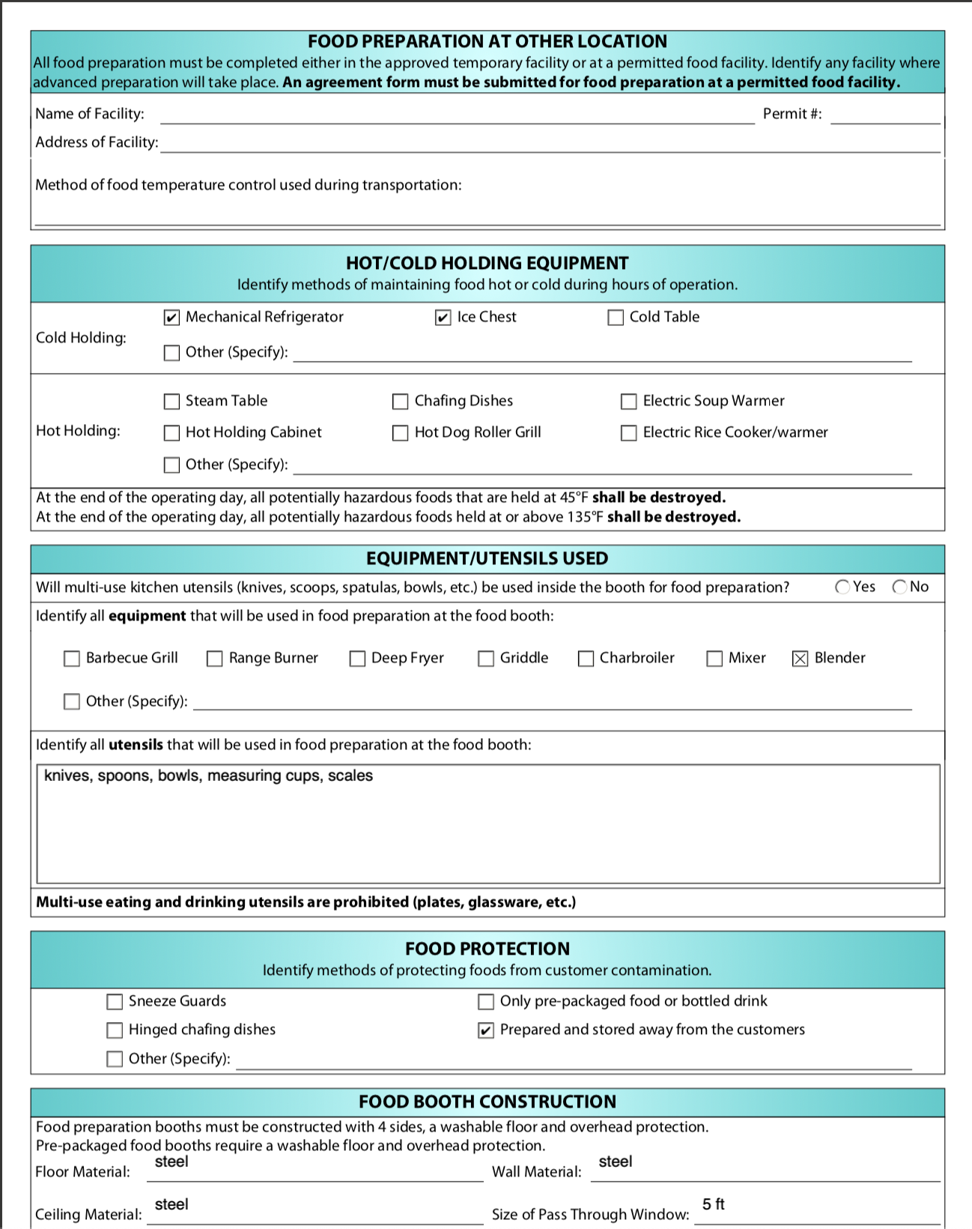
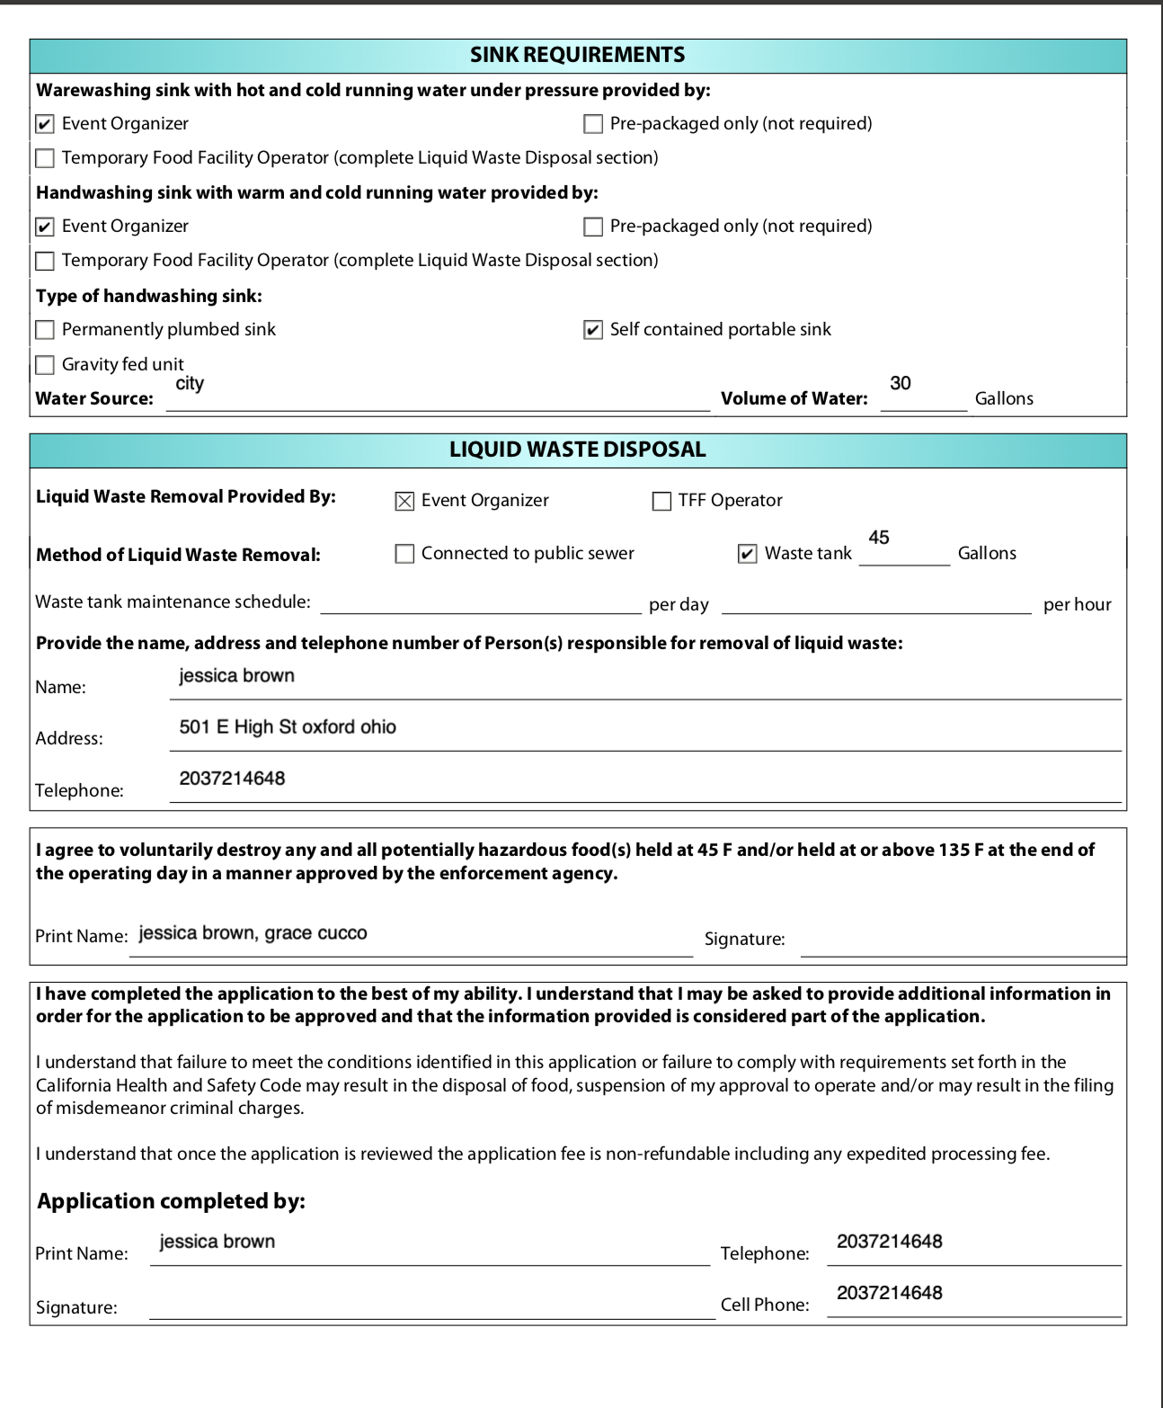
Temporary Food Handler Application
Notes:
Temp since we are seasonal

Slide 18
LEED
Gold level
One of our highest concerns is for the environment
Pull trailer
  allows us to use our already owned cars to pull the truck and use efficient, biodiesel fuel
Biodegradable cups, bowls, and utensils from Green Paper Products
Notes:
LEED quality is just as important to us as our product. While aim to provide top of the line products to consumers, our morals push us to do so for the environment as well.
Biodiesel fuel is developed from vegetable oils, animal fats, or recycled restaurant grease for use in diesel vehicles or any equipment that operates on diesel fuel. The form of which we will use is B20, which ranges from 6% to 20% biodiesel blended with petroleum diesel. The benefits of using this are as follows: increasing mileage on the vehicle, a positive energy balance, reduced nitrogen oxide emissions to nearly zero, it is safe to store due to a high flash point, and it improves engine operation.
To further out LEED qualities, we will be using biodegradable bowls, cups, straws, and spoons from Green Paper Products. These items are petroleum free, certified compostable, have a high temperature resistance, and are non-toxic and non-porous. All of these qualities drew our attention because they keep our environment and customers best interests in mind. With these qualities, we will be gold level LEED.

Slide 19
Staff
2 owners: The owners will be able to lend a hand when needed. They can fill in as managers or work as employees and take orders and make smoothies. They will run the social media as well.
2 managers: Managers will act as supervisors to make sure everything runs smoothly. They can take customer complaints, deal with emergencies, and get supplies if needed. They will know how to make smoothies and take orders and can cover for employees if necessary. They can also train new staff. ($20/hr)
8 employees: There will be 2 employees at every shift. One will make smoothies and one will take orders and collect money. We chose to have 8 employees so that their schedules can be flexible and these positions will switch off after their mid-day break ($11/hr)

Slide 20
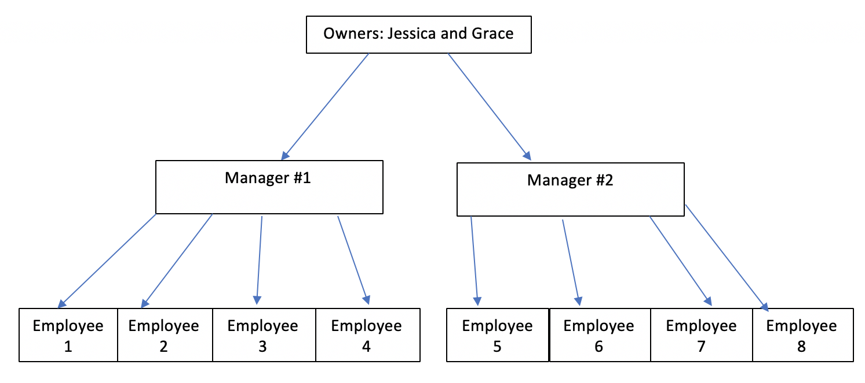
Organizational chart

Slide 21
Hiring process
All workers aged 15 - 18 must obtain a work permit and submit to school district
Interview
Hire
Training
ServSafe certification
Notes:
Individuals who apply on our website for this seasonal job lasting from May to September will be be called for an in-person interview.
This interview will ask basic questions to guide a conversation to see if they are able to engage customers in the way we desire. We will be looking for personable, dependable, organized, efficient, and good problem solving characteristics in the individual, people who value the concern for food allergen protection and awareness, those who value sustainability, and those who see our values as unique and worthwhile.
For managers, a degree in a business related field is preferred although we will highly consider those who have a background in nutrition or public health related field. They must have at least 1-2 years of experience in the business field, being through an internship or a position allocating them a salary. Moreover, we will accept entry-level managers. Their salary will be based on an hourly wage of $20.00/hour and work one hour before open and one hour before closing.
Managers must have an elite understanding of marketing technique, be able to problem solve efficiently, one who is passionate about their job, and must be able to mediate employee complications throughout the work day. They must be able to communicate effectively, schedule employees based on their availability, and be able to stay up to date of food expiration and stock, grey water emptying and cleaning schedules.
For all of these individuals, they must be able to go through a ServSafe certification and obtain a Food Handlers card within 30 days of hire, which we will provide for them.

Slide 22
Training
4 hours
  will be paid their hourly wage for their time.
Training will include new hire orientation discussing our values as a company, where we started, why we started, and what we hope to see of our company in one year.
They will receive a tour of the truck and be given an overview on how cleanliness is of out highest standards.
They will be taught how to make each smoothie efficiently, how to clean equipment, where each ingredient is located, how to use our ordering system, and what to do when we are out of an ingredient.
When completed, they must be able to make a smoothie in front of us in a timely manner and show proper food handling and cleanliness techniques.
Notes:
Training for general employees will occur, once they have obtained proper certifications, over one working day (4 hours) and will be paid their hourly wage for their time.
Training will include new hire orientation discussing our values as a company, where we started, why we started, and what we hope to see of our company in one year.
This will help immerse them into the small business community and hopefully make them feel like family to us as their hard work and dedication is beyond appreciated.
They will receive a tour of the truck and be given an overview on how cleanliness is of out highest standards.
They will be taught how to make each smoothie efficiently, how to clean equipment, where each ingredient is located, how to use our ordering system, and what to do when we are out of an ingredient.
When completed, they must be able to make a smoothie in front of us in a timely manner and show proper food handling and cleanliness techniques.

Slide 23

Training module: making “You Think You’re Smoother Than Me”

Slide 24
Policy and Procedure
Being an allergen friendly food truck, it is incredibly important to be as sanitary as possible.
  Change gloves before making a smoothie for a patron with specified coconut allergy
  Use Blendtec rapid rinse after making every smoothie
  When a customer with an allergy comes in, clean blender in use with warm water and soap and wipe down counter with cleaning wipe found above the sink
  Wear apron at all times
  Wash hands frequently
  Be sure to keep all ingredients separated to prevent cross contamination by keeping the caps on them and taking your time while making each smoothie or smoothie bowl.
Notes:
This requires employees to be wearing gloves at all times and change them as frequently as possible, especially when a patron notes an allergy to coconut or another ingredient on our menu.

Slide 25

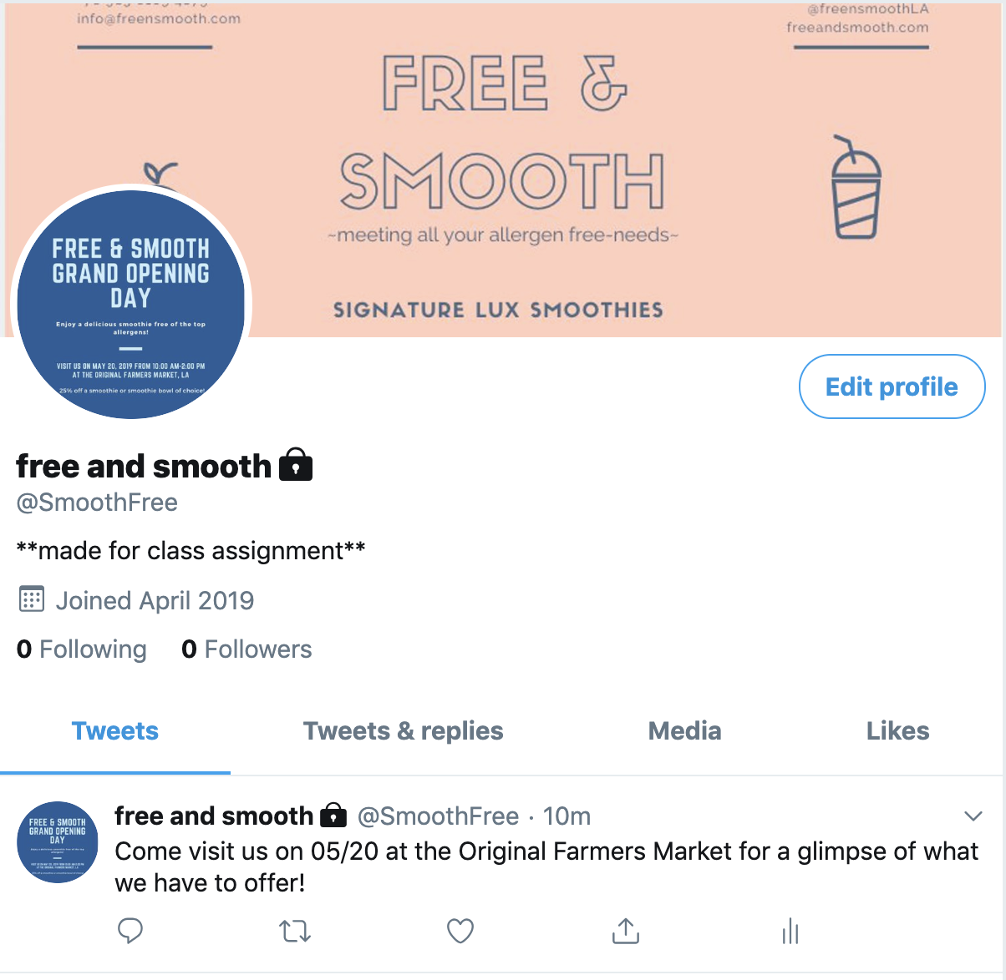

Marketing
Notes:
We plan to pass out punch cards as incentive to be a return customer. We will be using social media such as Facebook, Twitter, and Instagram to promote ourselves and any deals we are having.
We can also use social media to share our location, times we will be open, promotions, and host monthly giveaways.
We hope to spread our name around by word of mouth and will be open every week at the original farmer’s market where we expect to interact with numerous interested customers whom either have a food allergy and would like to be apart of the fun or would just like to try our brand.
To bring customers to our window while we are starting up, we will have free samples available to try.

